Slide 1
Psychology
Chapter 7 THINKING AND INTELLIGENCE
PowerPoint Image Slideshow

Slide 2
Figure 7.1
Thinking is an important part of our human experience, and one that has captivated people for centuries. Today, it is one area of psychological study. The 19th-century Girl with a Book by José Ferraz de Almeida Júnior, the 20th-century sculpture The Thinker by August Rodin, and Shi Ke’s 10th-century painting Huike Thinking all reflect the fascination with the process of human thought. (credit “middle”: modification of work by Jason Rogers; credit “right”: modification of work by Tang Zu-Ming)

Slide 3
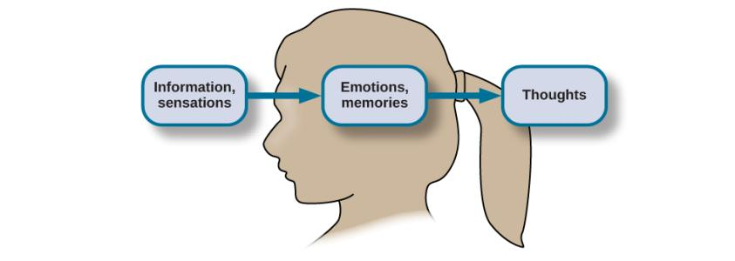
Figure 7.2
Sensations and information are received by our brains, filtered through emotions and memories, and processed to become thoughts.

Slide 4
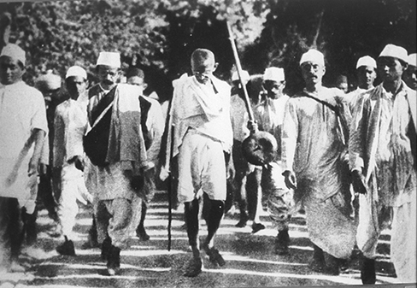
Figure 7.3
In 1930, Mohandas Gandhi led a group in peaceful protest against a British tax on salt in India.

Slide 5
Figure 7.4
(a) Our concept of snow is an example of a natural concept—one that we understand through direct observation and experience.
(b) In contrast, artificial concepts are ones that we know by a specific set of characteristics that they always exhibit, such as what defines different basic shapes. (credit a: modification of work by Maarten Takens; credit b: modification of work by “Shayan (USA)”/Flickr)

Slide 6
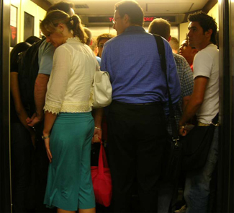
Figure 7.5
What event schema do you perform when riding in an elevator? (credit: “Gideon”/Flickr)

Slide 7
Figure 7.6
Texting while driving is dangerous, but it is a difficult event schema for some people to resist.

Slide 8
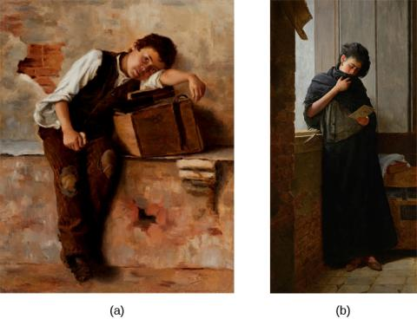
Figure 7.7
These two works of art depict saudade. (a) Saudade de Nápoles, which is translated into “missing Naples,” was painted by Bertha Worms in 1895. (b) Almeida Júnior painted Saudade in 1899.

Slide 9
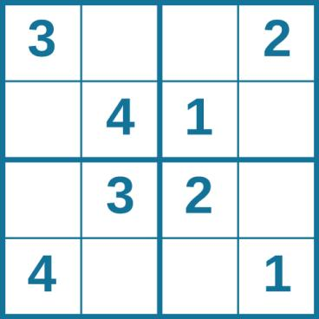
Figure 7.8
How long did it take you to solve this sudoku puzzle? (You can see the answer at the end of this section.)

Slide 10
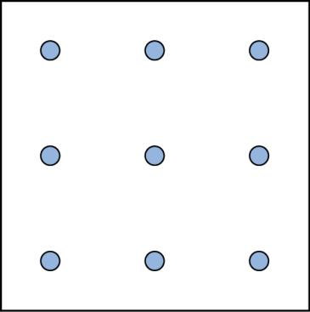
Figure 7.9
Did you figure it out? (The answer is at the end of this section.) Once you understand how to crack this puzzle, you won’t forget.

Slide 11
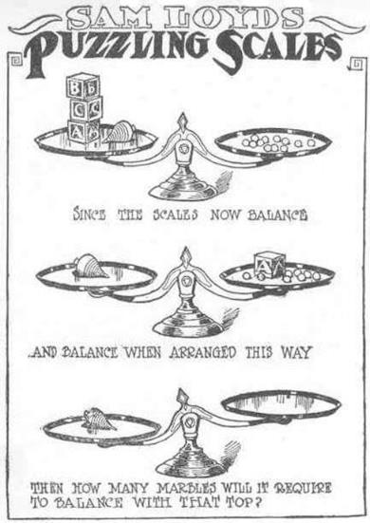
Figure 7.10
What steps did you take to solve this puzzle?

Slide 12
BLANK Title
Were you able to determine how many marbles are needed to balance the scales in Figure 7.10? You need nine

Slide 13
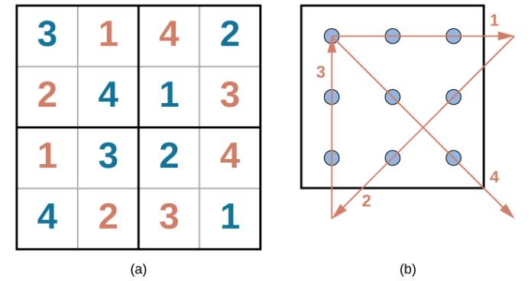
Figure 7.11
Were you able to solve the problems in Figure 7.8 and 7.9? Here are the answers

Slide 14
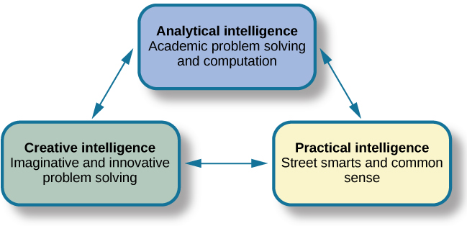
Figure 7.12
Sternberg’s theory identifies three types of intelligence: practical, creative, and analytical.

Slide 15
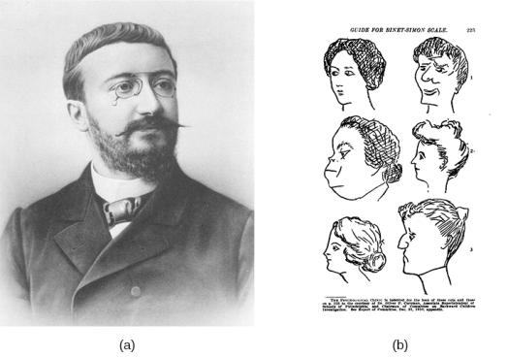
Figure 7.13
French psychologist Alfred Binet helped to develop intelligence testing. (b) This page is from a 1908 version of the Binet-Simon Intelligence Scale. Children being tested were asked which face, of each pair, was prettier.

Slide 16
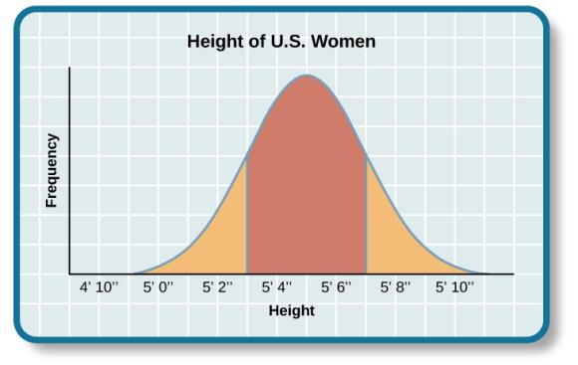
Figure 7.14
Are you of below-average, average, or above-average height?

Slide 17
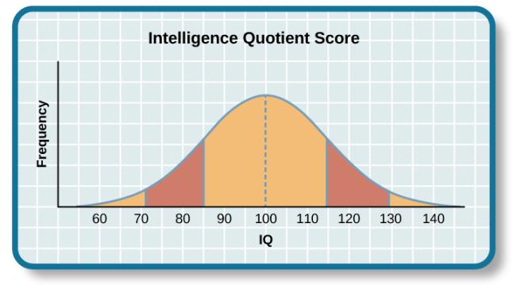
Figure 7.15
The majority of people have an IQ score between 85 and 115.

Slide 18
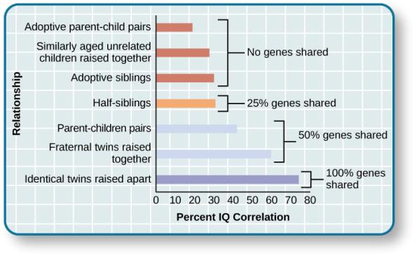
Figure 7.16
The correlations of IQs of unrelated versus related persons reared apart or together suggest a genetic component to intelligence.

Slide 19
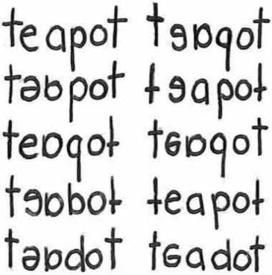
Figure 7.17
These written words show variations of the word “teapot” as written by individuals with dyslexia.

