Slide 1
Psychology
Chapter 13 INDUSTRIAL-ORGANIZATIONAL PSYCHOLOGY
PowerPoint Image Slideshow

Slide 2
Figure 13.1
What does an office look like? For people who telecommute, their workspace may be adapted to fit their lifestyle. (credit: “left”: modification of work by Cory Zanker; credit “center”: modification of work by “@Saigon”/Flickr; credit “right”: modification of work by Daniel Lobo)

Slide 3
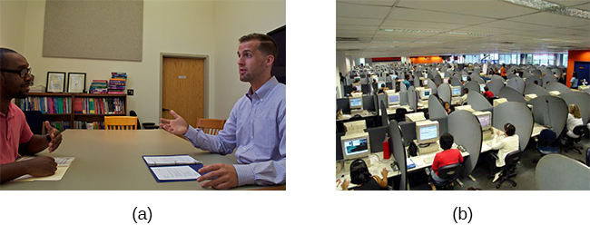
Figure 13.2
(a) Industrial psychology focuses on hiring and maintaining employees.
(b) Organizational psychology is interested in employee relationships and organizational culture. (credit a: modification of work by Cory Zanker; credit b: modification of work by Vitor Lima)

Slide 4
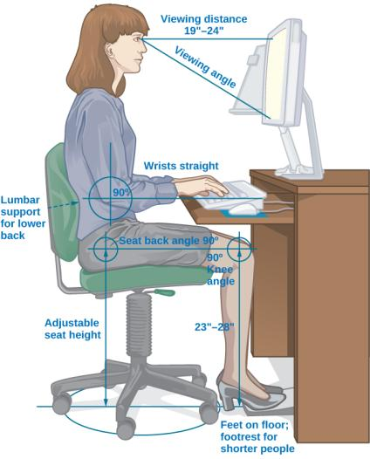
Figure 13.3
Human factors psychology is the study of interactions between humans, tools, and work systems.

Slide 5
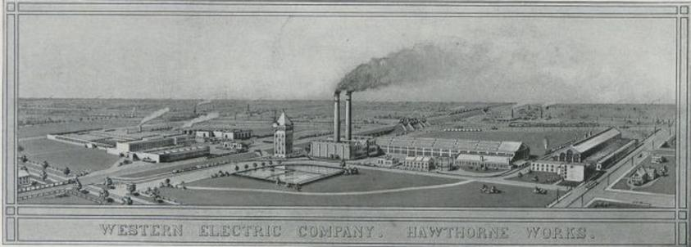
Figure 13.4
Hawthorne Works provided the setting for several early I-O studies.

Slide 6
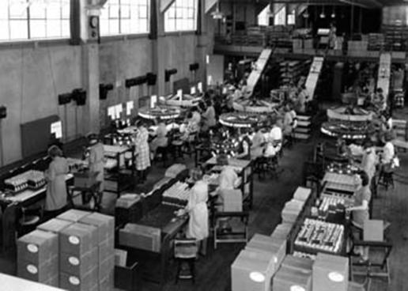
Figure 13.5
Researchers discovered that employees performed better when researchers or supervisors observed and interacted with them, a dynamic termed the Hawthorne effect.

Slide 7
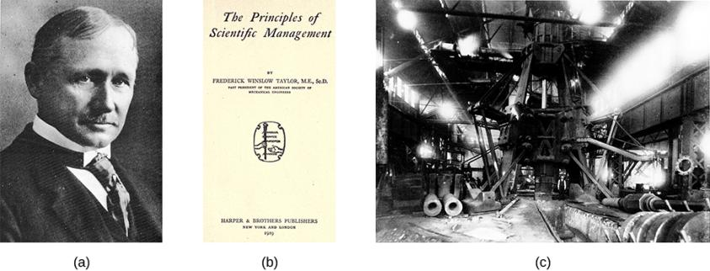
Figure 13.6
(a) Frederick Taylor (1911) strived to engineer workplaces to increase productivity, based on the ideas he set forth in (b) his book, The Principles of Scientific Management. (c) Taylor designed this steam hammer at the Midvale Steel Company. (credit c: modification of work by “Kheel Center, Cornell University”/Flickr)

Slide 8
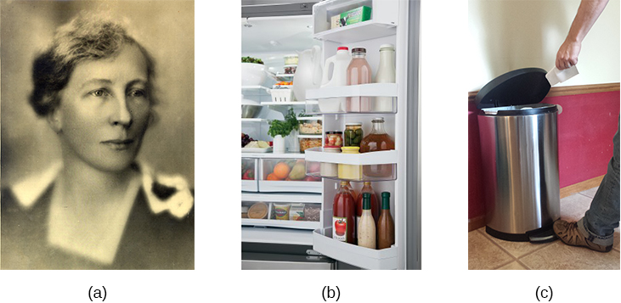
Figure 13.7
(a) Lillian Gilbreth studied efficiency improvements that were applicable in the workplace, home, and other areas. She is credited with the idea of (b) putting shelves on the inside of refrigerator doors and (c) foot-pedal-operated garbage cans. (credit b: modification of work by “Goedeker’s”/Flickr; credit c: modification of work by Kerry Ceszyk)

Slide 9
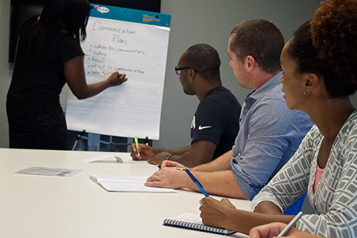
Figure 13.8
Training usually begins with an orientation period during which a new employee learns about company policies, practices, and culture. (credit: Cory Zanker)

Slide 10
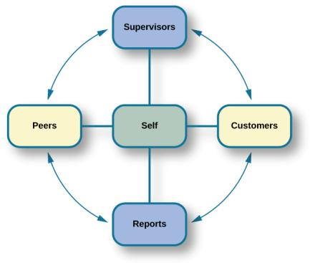
Figure 13.9
In a 360-degree performance appraisal, supervisors, customers, direct reports, peers, and the employee himself rate an employee’s performance.

Slide 11
Figure 13.10
(a) Pregnancy, (b) religion, and (c) age are some of the criteria on which hiring decisions cannot legally be made. (credit a: modification of work by Sean McGrath; credit b: modification of work by Ze’ev Barkan; credit c: modification of work by David Hodgson)

Slide 12
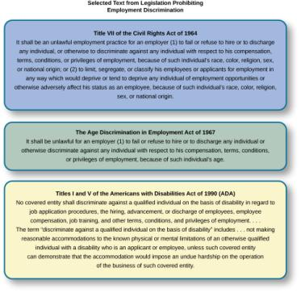
Figure 13.11
The laws shown here protect employees in the U.S. from discriminatory practices.

Slide 13
Figure 13.12
Hooters restaurants only hire female wait staff. (credit: “BemLoira BemDavassa”/Flickr)

Slide 14
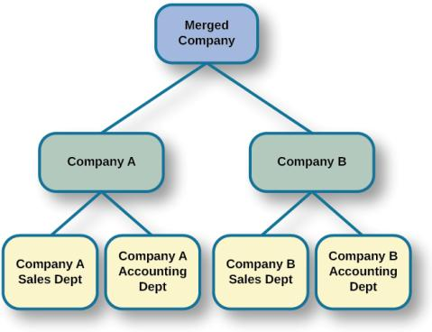
Figure 13.13
When companies are combined through a merger (or acquisition), there are often cuts due to duplication of core functions, like sales and accounting, at each company.

Slide 15
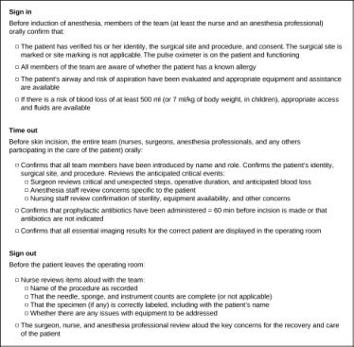
Figure 13.14
Checklists, such as the WHO surgical checklist shown here, help reduce workplace accidents.

